Slide 1
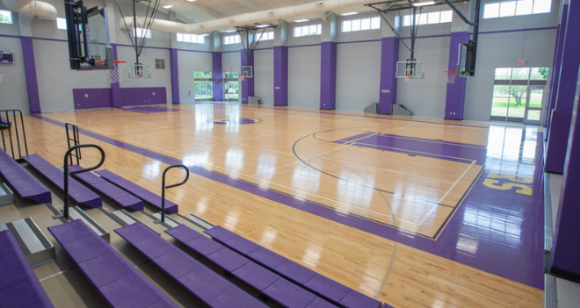
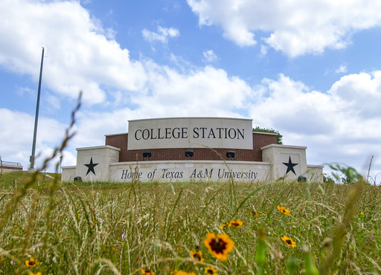
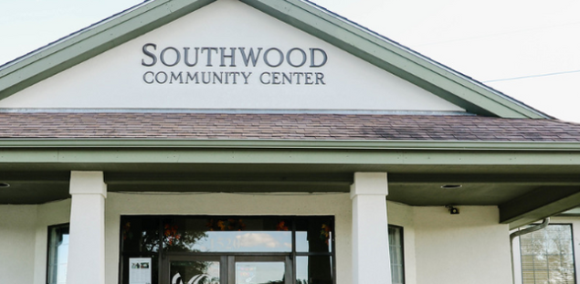


COLLEGE STATION
PHASE 1 FINDINGS
August 22, 2024
RECREATION CENTER STUDY
BALDRIDGE REGIONAL PARK

Slide 2
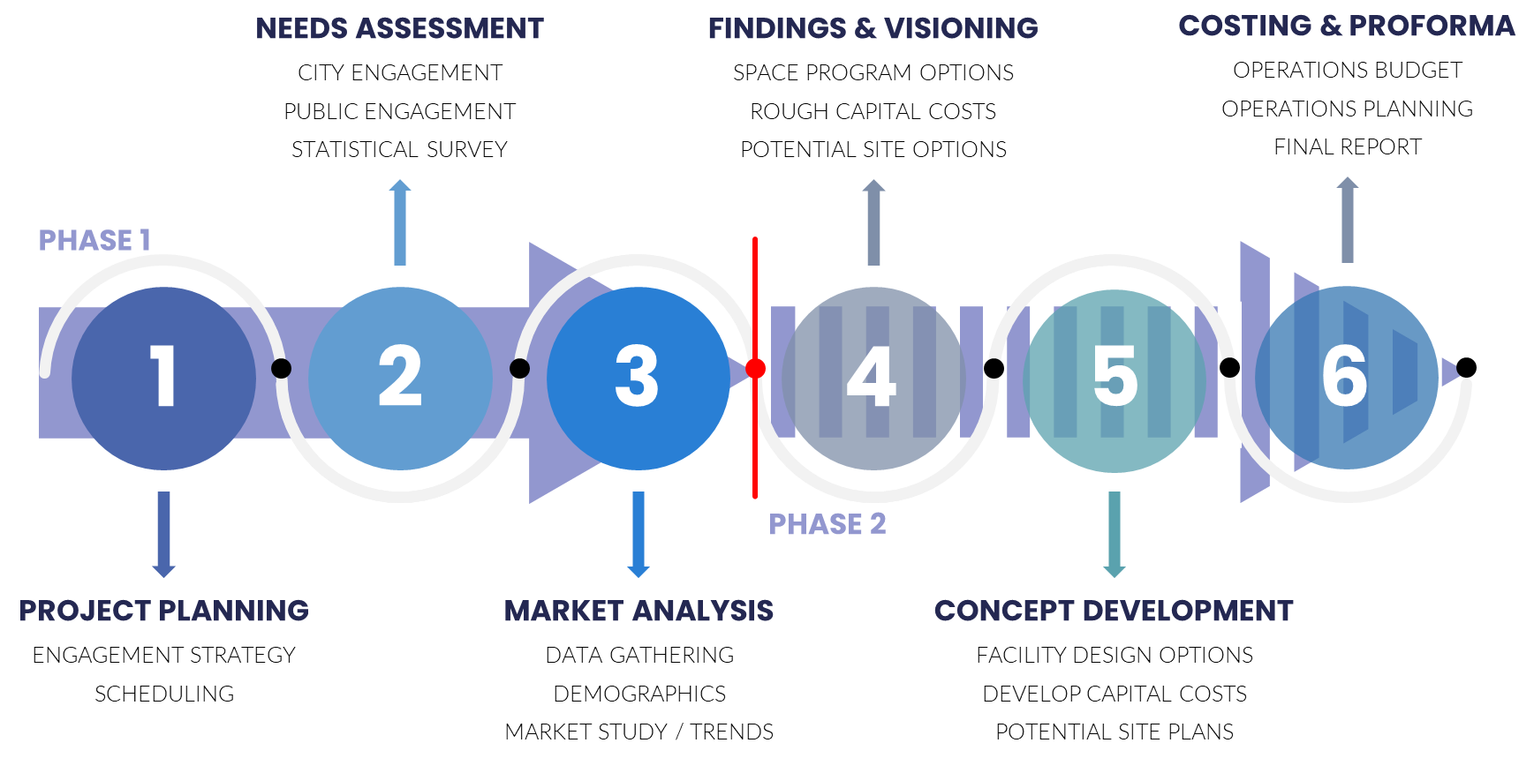
Is a new community recreation center feasible in the City of College Station?
Introduction
ETC Institute (2024)

Slide 3
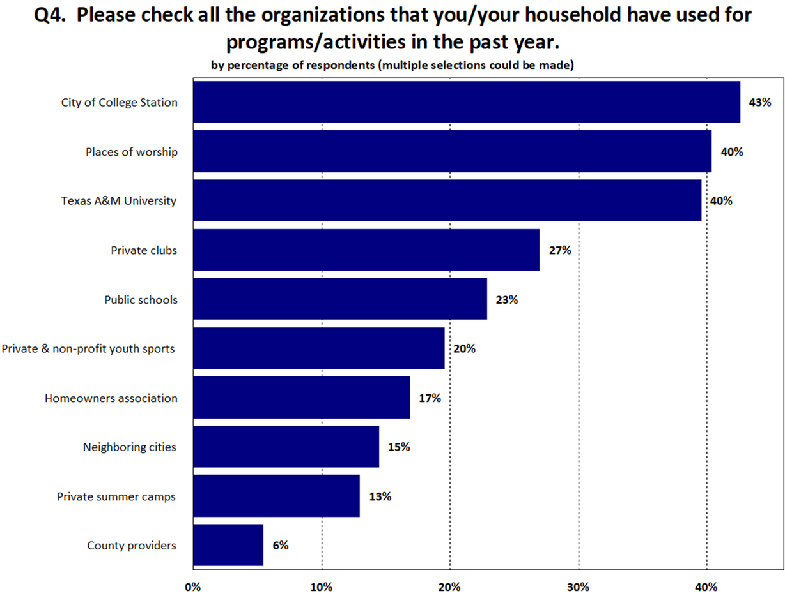
Statistically Valid Survey
2
455
Survey Process
completed surveys
Utilizes a random sampling and demographic data to ensure results are representative of the entire population
Surveys are distributed through mail and administered through multiple platforms
Standardized data is collected and analyzed to allow for benchmarking against other communities
ETC Survey Findings Report, Page ii
The full survey report is included in your packet
3
ETC Institute (2024)

Slide 4
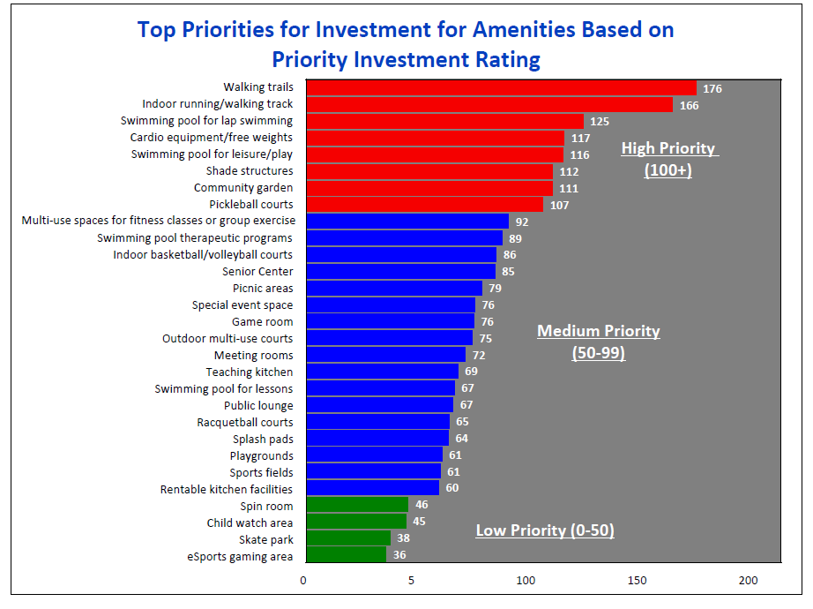
2
Needs Assessment Findings
High Priority Indoor Amenities
Indoor running/walking track
Swimming pool for lap swimming
Cardio equipment/free weights
Swimming pool for leisure/play
Pickleball courts
Medium Priority Indoor Amenities
Multi-use spaces for fitness spaces or group exercise
Swimming pool therapeutic programs
Indoor basketball/volleyball courts
Senior Center
Special event space
Game room
Meeting rooms
Teaching kitchen
Swimming pool for lessons
ETC Survey Findings Report, Page 5
4
ETC Institute (2024)

Slide 5
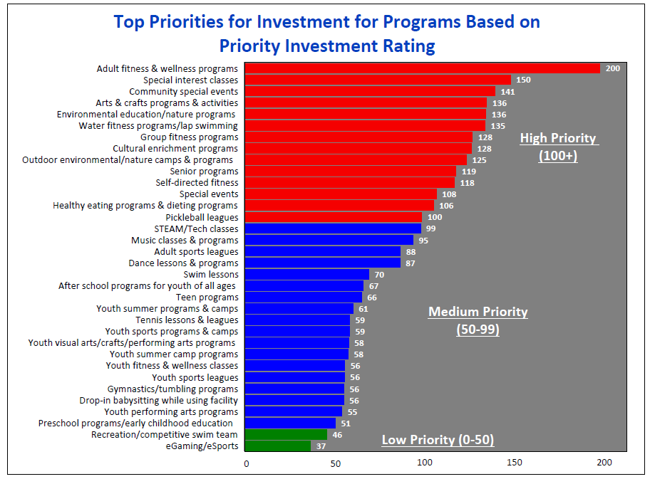
Needs Assessment Findings
2
High Priority Programs
1. Adult fitness and wellness programs
2. Special interest classes
3. Community special events
4. Arts and crafts programs and activities
5. Environmental education/nature programs
6. Water fitness programs/lap swimming
7. Group fitness programs
8. Cultural enrichment programs
9. Outdoor environmental/nature camps and programs
10. Senior programs
11. Self-directed fitness
12. Special events
13. Healthy eating programs and dieting programs
14. Pickleball leagues
ETC Survey Findings Report, Page 5
5
ETC Institute (2024)

Slide 6
Engagement Findings
2
Key Themes
Staff Engagement
11
Discovery Sessions
Residents desire a family-oriented facility that serves all ages
Identified strengths include youth programs, sports leagues, and senior facilities
Noted weaknesses are the absence of an indoor pool, insufficient indoor recreational facilities, and low staffing levels
Many open house attendees emphasized the need for pickleball courts, year-round indoor lap and leisure pools, and gymnasium/fitness areas
30
City Leaders and Staff
Public Engagement
7
Focus Groups
40
Attendees
2
Public Open Houses
39
Participants
Engagement Results Report, Page 1
6
ETC Institute (2024)

Slide 7
3
Current Facilities
The City of College Station’s Parks and Recreation Department is an award-winning agency, offering extensive recreational programs, events, parks, and facilities.
56
Developed Parks
2
Splash Pads
2
OutdoorPools
Lincoln Recreation Center
Southwood Community Center
Bob and Wanda Meyer Senior & Community Center
  Two gymnasiums
  Game Room
  Fitness Room
  Multipurpose rooms
  Splash pad
  13,000 ft. pavlion
  4,700 square-foot facility
  meeting/party room
  Access to amenities in Brian Bachmann Community Park
  Space for seniors to socialize
  Active and passive activities
  3 multipurpose rooms
  Arts and crafts room
7
ETC Institute (2024)

Slide 8


















Benchmarking Review
3
Texas and similar benchmarked college communities’ median of 4.2 community centers suggests that the City of College Station provides fewer community centers or recreation than benchmarked parks and recreation agencies.
Recreation Centers
Community
Centers
Senior
Centers
Teen Centers
1.0
1.0
1.0
1.3
4.2
1.0
1.0
2.1
1.9
1.0
1.0
2.3
4.2
1.3
1.7
Market Analysis Report, Page 13
8
ETC Institute (2024)

Slide 9
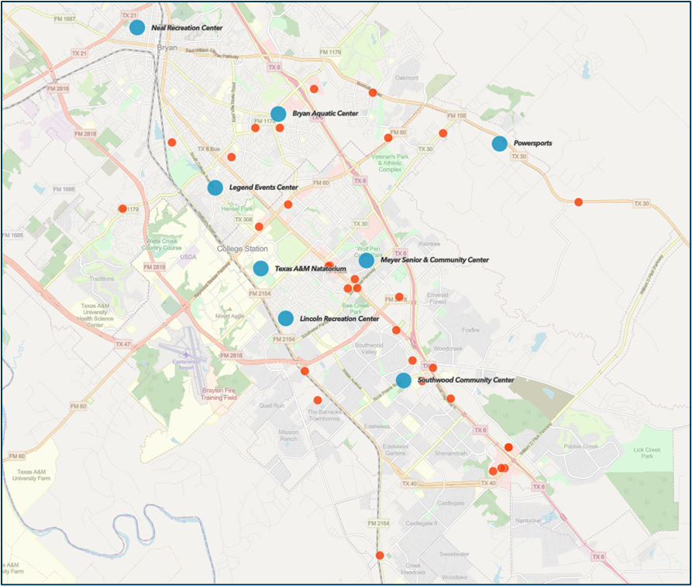
Similar Providers
3
To be competitive and fill market gaps, a new center might focus on offering unique or underserved services, or alternatively, look for synergies with niche facilities to offer a range of programs.
8+
multi-service similar facilities
30+
niche providers in the area
  Legends Event Center
  Lincoln Recreation Center*
  Meyer Senior and Community Center*
  Neal Recreation Center
  Powersports
  Southwood Community Center*
  Texas A&M Student Recreation Center
*City of College Station facility
Market Analysis Report, Page 16
9
ETC Institute (2024)

Slide 10
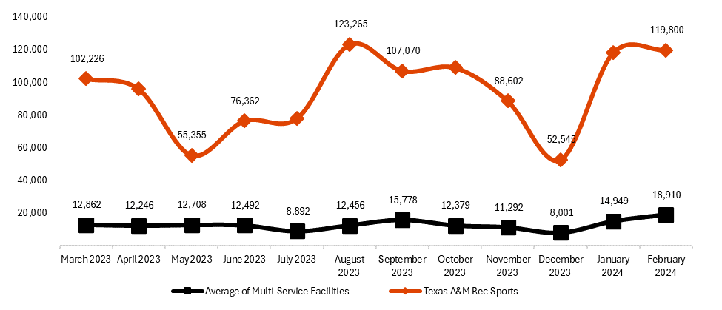
Visitation Data
3
There is significant use of facilities at the University year-round, with typical school year peaks and valleys.
Other multi-service facilities in the area show a more consistent level of visitation and demonstrate a significantly lower average visitation.
Market Analysis Report, Page 23
10
ETC Institute (2024)

Slide 11

Travel Distance
3
  This can help understand the target market for consideration of new facility in Phase 2 site selection.
  Average travel distance to other facilities
    30% travel under three miles
    65% travel between 3-10 miles
Market Analysis Report, Page 24
11
ETC Institute (2024)

Slide 12
Summary
The College Station community needs more indoor recreation opportunities.
Top needs related to indoor spaces:
Multi purpose/family oriented
Walking track
Swimming pools
City-operated
College Station offers fewer facilities than benchmarked communities.
College Station’s Parks and Recreation Department offers very limited indoor recreational opportunities.
As the community grows, City-provided indoor facilities could expand service offerings to meet increased demand.
Texas A&M recreation facilities are student-focused and are not widely used by public.
Annual Visits: Estimated 1.2 million visits to the Texas A&M Rec Sports facility annually.
Target Demographic: A significant portion of the target demographic is well-served.
Membership Usage: Does not offer non-affiliate memberships; not widely used by the general public.
12
ETC Institute (2024)

Slide 13
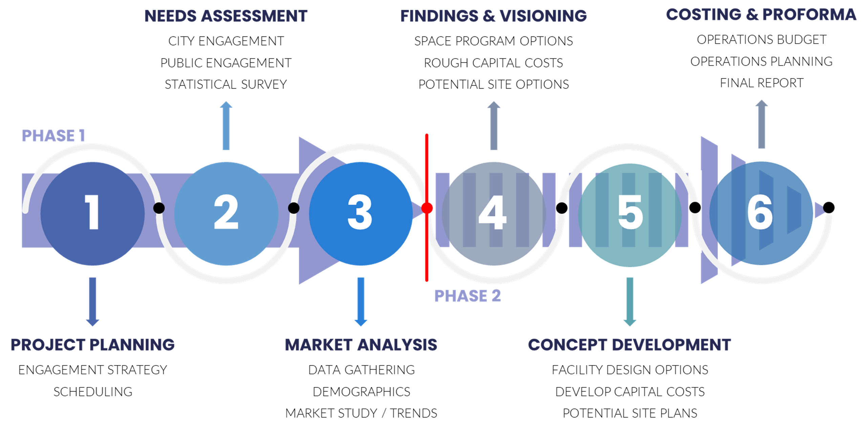
Next Steps
Option 1: Proceed with Phase 2 of study, which is to start space program options and rough costing.
Option 2: Pause or stop the process.
Questions?
13
ETC Institute (2024)

